Slide 1
3.Python Collections and Sequences

Slide 2
General Guideline
© (2021) ABES Engineering College.
This document contains valuable confidential and proprietary information of ABESEC. Such confidential and proprietary information includes, amongst others, proprietary intellectual property which can be legally protected and commercialized. Such information is furnished herein for training purposes only. Except with the express prior written permission of ABESEC, this document and the information contained herein may not be published, disclosed, or used for any other purpose.

Slide 3
Objective of Collections/Sequences
To describe the importance of list , string, tuple , dictionary and set in python
To uses to store multiple data values.
To use the index to update, add, and remove items
To use the data structures with out indexes
To explain the difference among different Collections
To select collections built-in functions in Python to write programs in Python.

Slide 4
Topics Covered
Day 1
Day 2
Day 3
Day 4
3.1 Introduction
3.2 String
Creation of String
Accessing the String
3.2 String
Updation
Deletion
Built-in-methods
Operations
String Formatters
Loops with Strings
3.3 List
Creation
Accessing
Update
Built in methods
3.3 List
Loops
Nested List
List Comprehensions

Slide 5
Topics Covered
Day 5
Day 6
Day 7
Day 8
3.4 Tuple
Creation
Accessing
Modification
Built in Methods
Operations
3. 5 Dictionary
Creation
Accessing
Modification
3.5 Dictionary
Built in Methods
Loops and Conditions
3.6 Set
Creation
Assessing
Modification
Built in methods
Operators
Loops
Frozen set

Slide 6
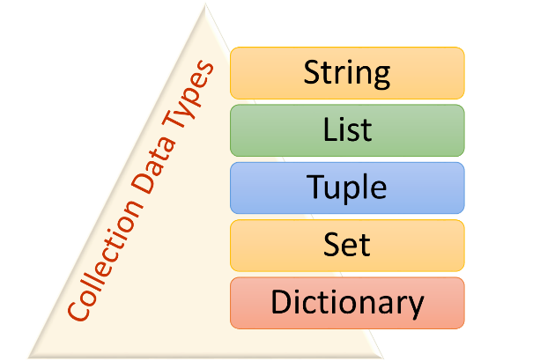
Introduction
In real life we need to store data like-
Name of students – A sequence of alphabet character
Marks of n students – A sequence of either integer or float value
Student’s record – A sequence of name, branch, roll number, address etc
So to represent these type of data in python provides us some built in collections.

Slide 7
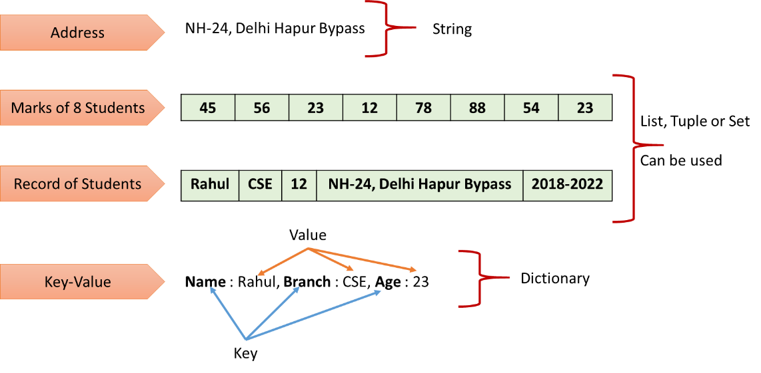
Contd…
Representation of Python Collections with the help of Figure:
If data is the combination of numeric data, alphanumeric or of different types than we go for List, Tuple or set .
If data is in the form of key-value pair than we go for dictionary.

Slide 8
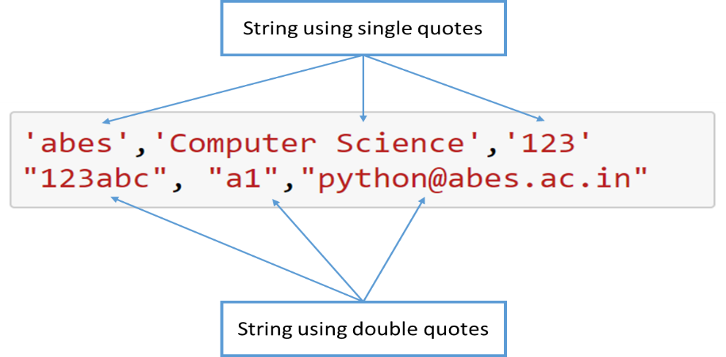
String
A string is a sequence of alphanumeric and
special character.
String is the collection of characters, it may
compose of alphanumeric and special
characters.
Strings are created in many ways using
single quotes or double-quotes.
Alphanumeric characters: a-z, A-Z, 0-9; Special symbol: *, -, +, $, @, whitespace …. etc

Slide 9
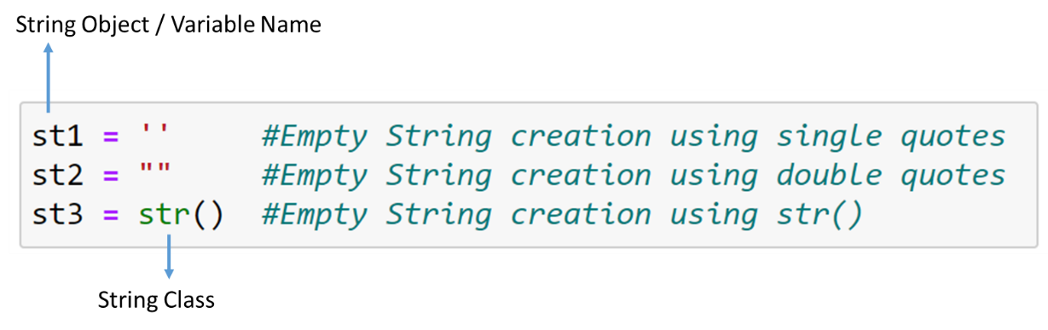
Creation of Empty String
Empty String
An empty string is a string having no character.
We have three ways to create an empty string as shown in syntax.
An Empty String is created by single quotes, double quotes and str().

Slide 10
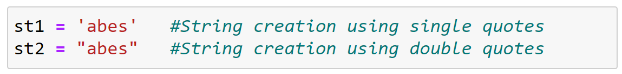
Creation of Non Empty String
A non-empty string is a sequence of alphanumeric character with at least one character.
A non-empty string is created by using single quotes and double quotes

Slide 11
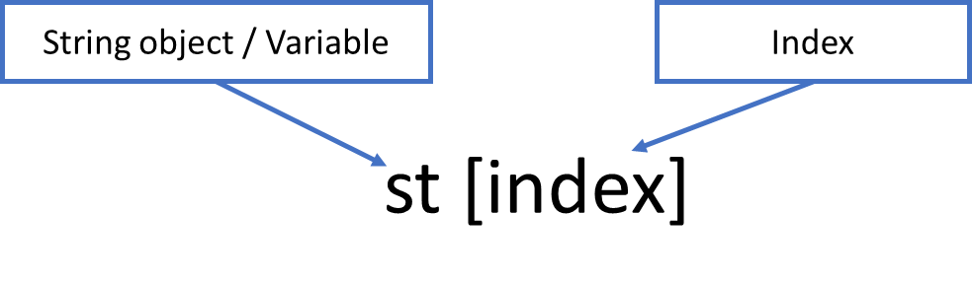
Assessing the String
String Element can be accessed using Square Bracket.
These Square brackets [ ] take an index as input.
In Python we have two types of Indexing.
Positive Indexing
Negative Indexing

Slide 12
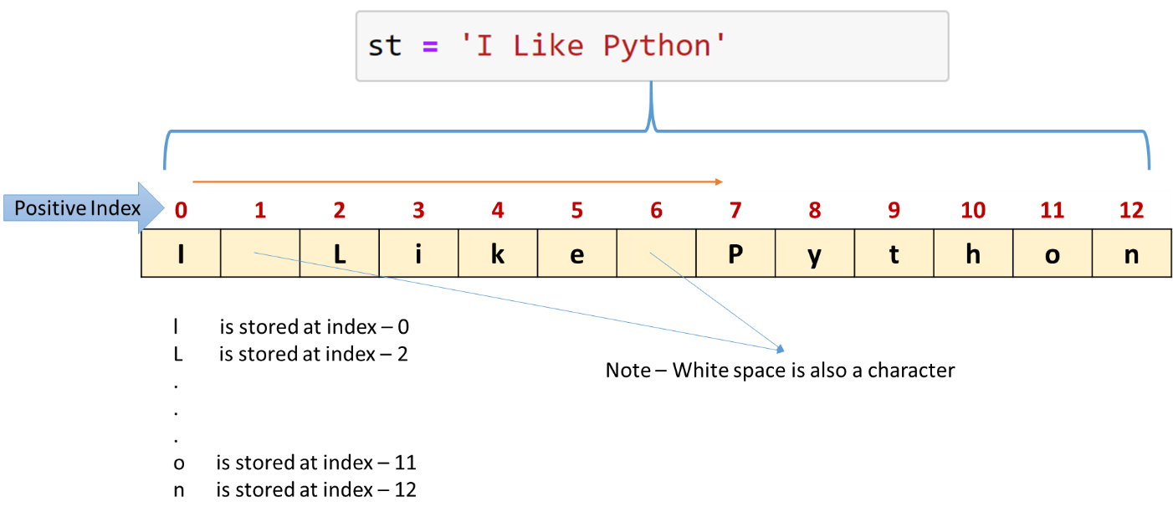
Positive Indexing
Positive indexing start from Zero (0) and from left hand side i.e. first character store at index 0, second at index 1 and so on.
Every character of string has some index value.

Slide 13
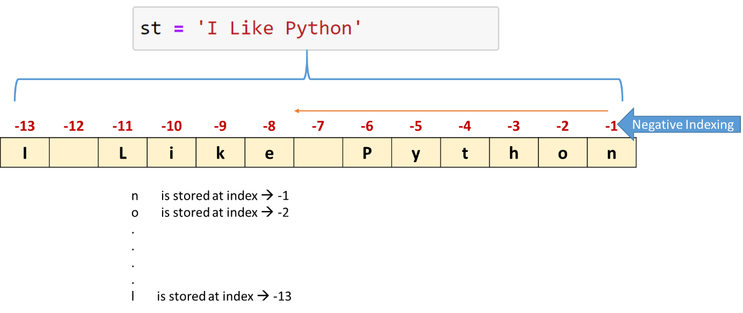
Negative Indexing
Negative Indexing starts from negative indexing start from -1 and from right-hand side.
Last character store at index -1 and as we move towards the left, it keeps increasing like -2, -3, and so on.

Slide 14
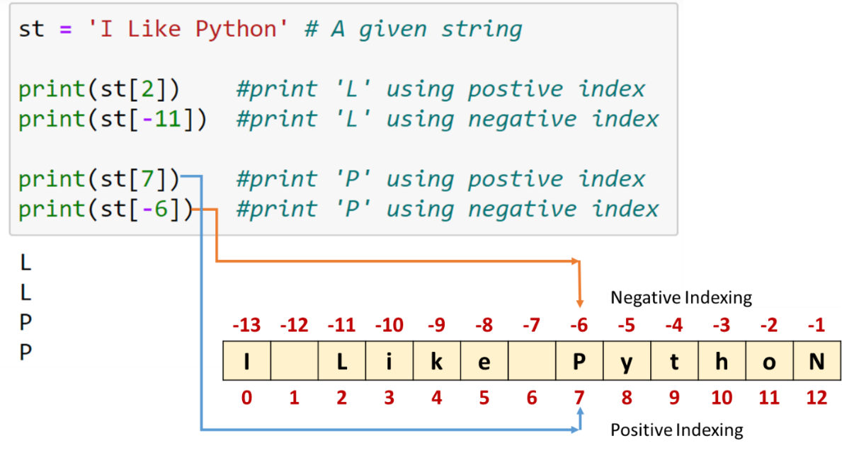
Example
Write a program to print character 'P' and 'L' using positive indexing and negative indexing. Assume a string st = 'I Like Python’, is given.

Slide 15
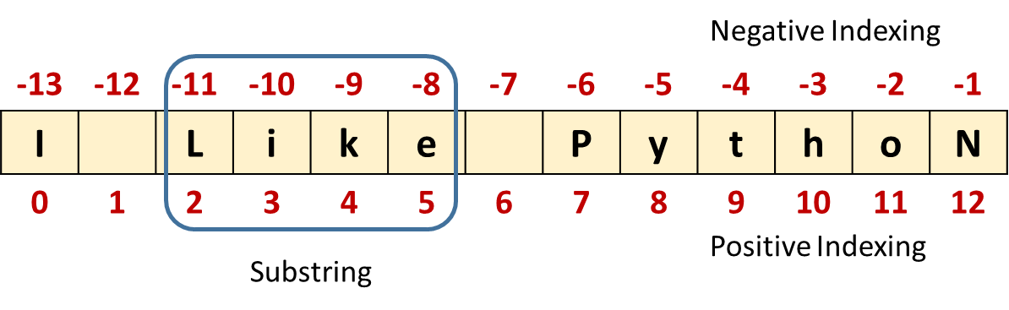
String Slicing
String slicing is the way of selection of substring.
String 'Like' is substring in given 'I Like Python' string.
[] we can access string characters by giving indexes if we use colon inside square bracket like [:] it becomes a slicing operator in Python.

Slide 16
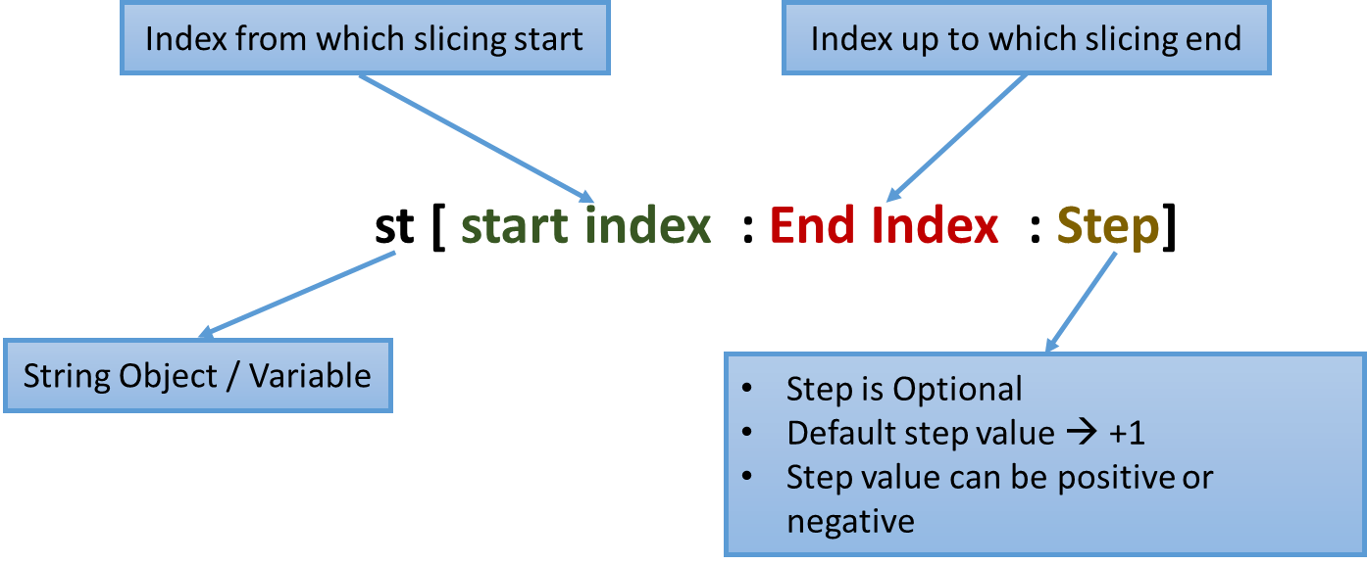
Syntax of String Slicing
Start index: Index from which slicing starts.
End Index: Index up to which slicing end.
Step value is optional.

Slide 17
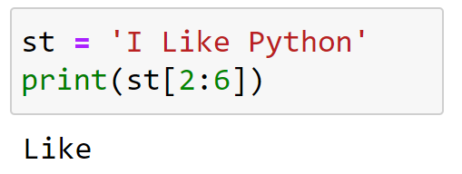
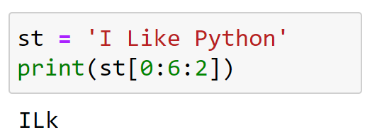
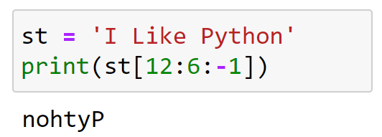
Examples of String Slicing
Example | Explanation | Syntax
st[ 2 : 6 ] | It starts with the 2nd index and ending with (6It starts with the 2nd index and ending with (6-1=5)th index.-1=5)^{th} index.
st[ 0 : 6 : 2 ] | It starts with index 0th and end with (6-1=5) ^{th}. Step is 2 So, it will give value at index 0,2,4
st[ 12 : 6 : -1] | It starts slicing from 12th index up to 6-1=5th index. 12th to 6th in opposite direction because step is negative.

Slide 18
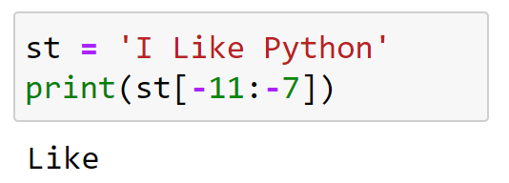
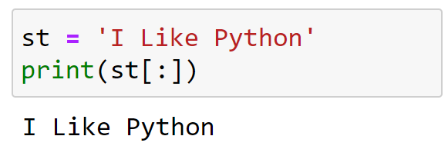
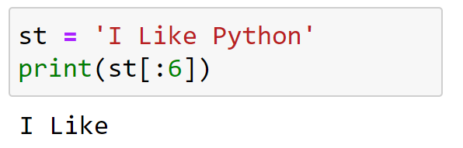
Contd..
Example | Explanation | Syntax
st[ -11 : -7 ] | It starts with -11th index and ending with (-7-1 = -8)th index.
[ : ] | The operator gives the complete original string.*
[ : 6 ] | Start index is missing and step is +1, So it will start from 0 till 6-1=5th index.*

Slide 19
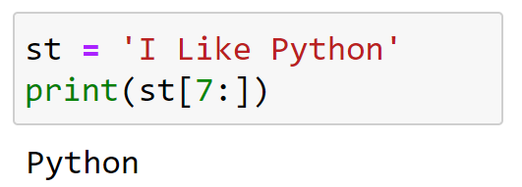
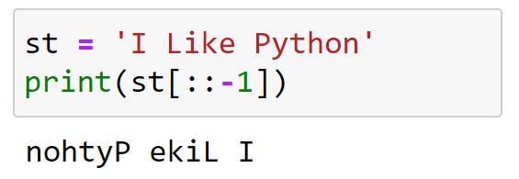
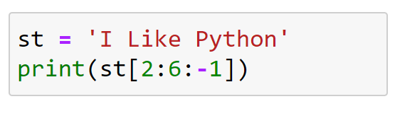
Contd..
Example | Explanation | Syntax
st[ 7 : ] | It will start from index 7 to last index ( Last index missing )*
st[ : : -1] | Step is -1, So start index will be the last index and end index will be first index when start and end is missing.
st[ 2 : 6 : -1 ] | This is explaining in Note Section ** Output – Empty string

Slide 20
Important Points to Remember
Note about *, **
* When start index is missing it will start from either first character or from last. It depends on step sign (positive or negative).
* When end index is missing it will execute till last character or first character. It depends on step sign (positive or negative).
* When we take negative steps it will scan from start to end in opposite direction.
** In the case of step is positive or negative the slicing will be done as below given algorithm.

Slide 21
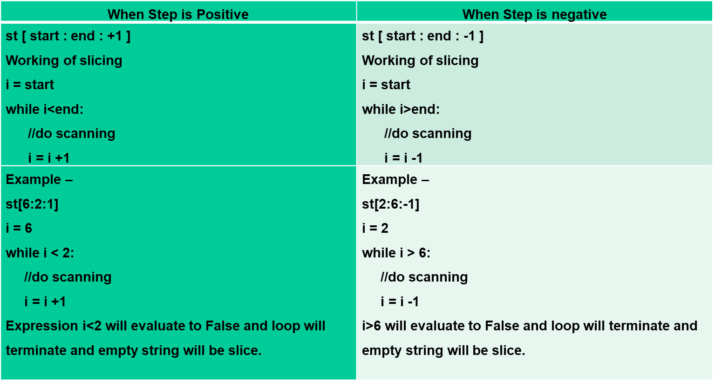
Comparison

Slide 22
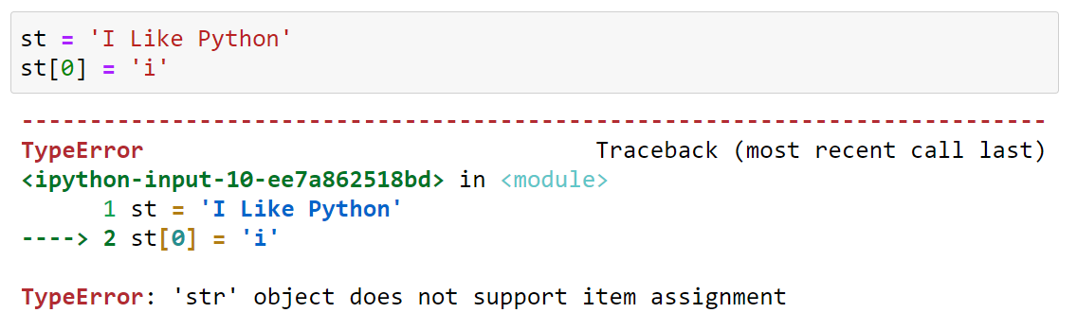
Updation in String
Strings in python are Immutable(un-changeable) sequences, which means it does not support new element assignment using indexes.
Lets try to understand this concept with the help of an example
In the above example string does not allow assigning a new element, because item assignment does
not support by string.

Slide 23
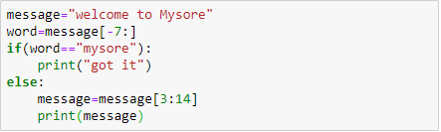
Contd..
What will be the output of the following code snippets?
come to Myso
come to Mys
lcome to Mys\
lcome to Myso

Slide 24
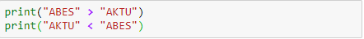
Contd..
2. What will be the output of the following code Comparison?
True
False
B. False
False

Slide 25
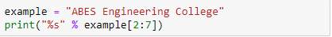
Contd..
3. What will be the output of the following code snippet?
ES
En
ES En
ESEn

Slide 26
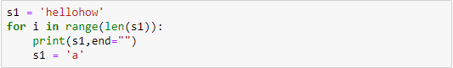
Contd..
4. What will be the output of the following code snippet?
hellohowa
hellohowaaaaa
hellohowaaaaaaa
Error

Slide 27
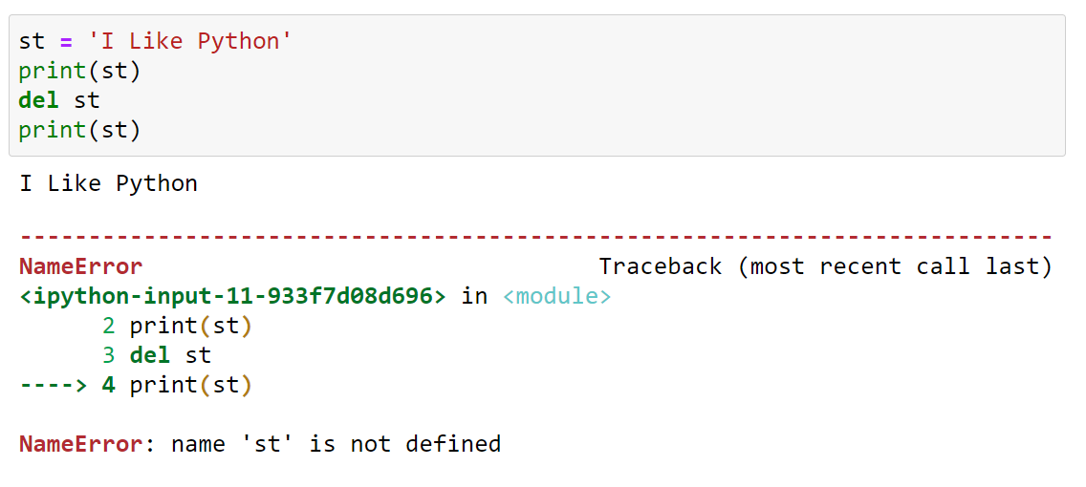
Deletion
In String, we can’t reassign the string characters but we can delete the complete string using del command.
Lets try to understand this concept with the hep of an example
In the above example , after deletion when we try to print the string st it gives NameError : st not defined.

Slide 28
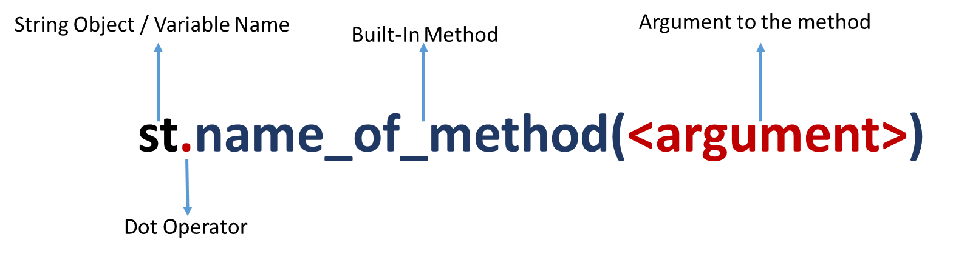
String Built in methods:
String supports a variety of Built-In methods for achieving different types of functionalities.
All built-in methods provide us to use as plug and play, we do not have to implement it.
In python methods are called using dot(.) operator

Slide 29
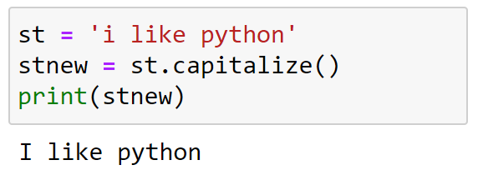
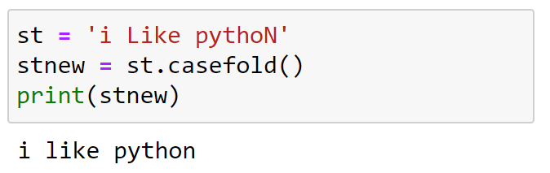
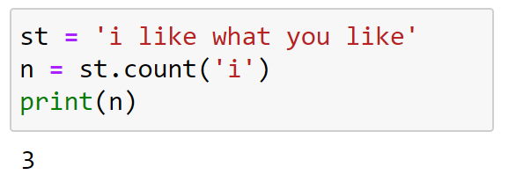
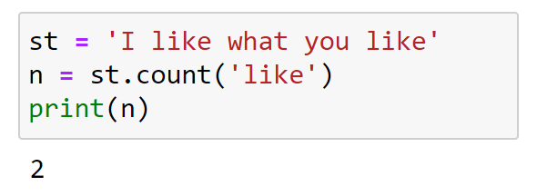
String Built in methods:
Method Name | Explanation | Code Snippet
capitalize() | Return a string with first letter capital e.g. i like python → I Like Python
casefold() | Return string in lowercase
count() | Return the number of occurrence of substring. In the first example “i” occurred 3 times. In the second example “like” occurred 2 times.

Slide 30
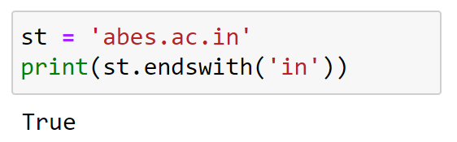
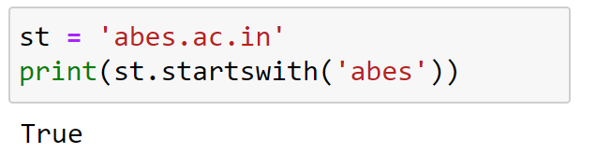
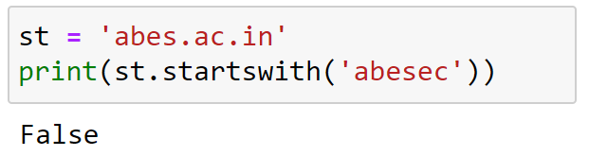
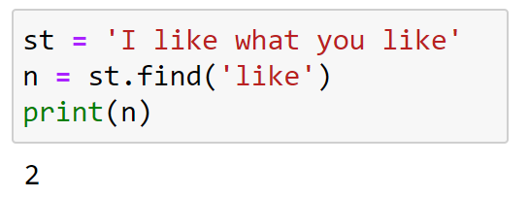
String Built in methods:
Method Name | Explanation | Code Snippet
endswith() | Return True if the string ends with the given substring otherwise return False.
startswith() | Returns True if the string starts with the given substring otherwise return False.
find() | Return the lowest index in String where substring sub is found. In example – there are two “like”. 1st “like” is at index-2 and 2nd at index-16. It return 2.

Slide 31
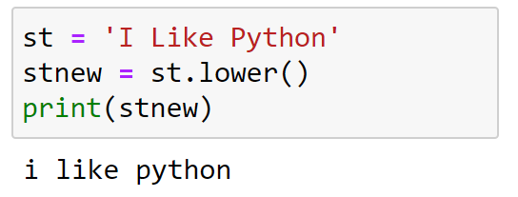
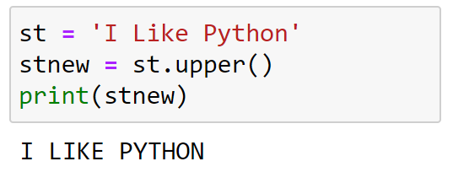
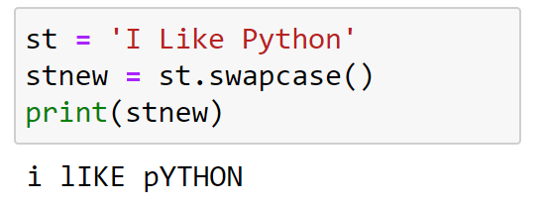
String Built in methods:
Method Name | Explanation | Code Snippet
lower() | Convert and return a string into lower case
upper() | Convert and return a string into upper case
swapcase() | In swaps cases, the lower case becomes the upper case and vice versa

Slide 32
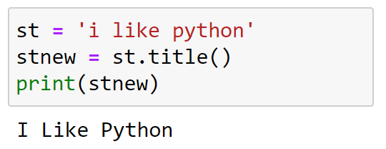
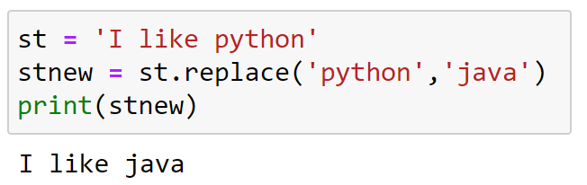
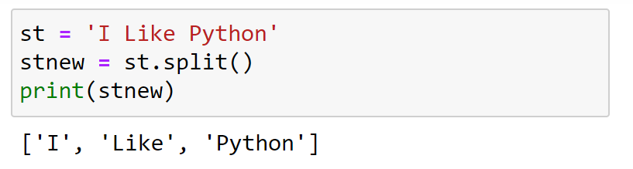
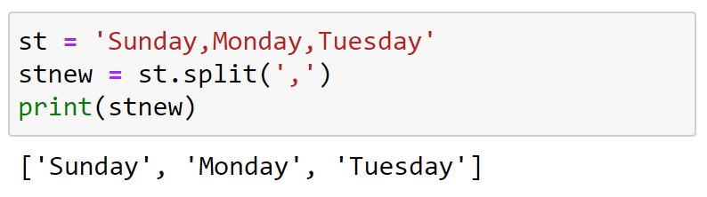
String Built in methods:
Method Name | Explanation | Code Snippet
title() | Converts the first character of each word to upper case.
replace() | Returns a string after replacing old substring with new substring.
split() | Splits the string from given separator and returns a list of substring. Note – By default, value of separator is a whitespace

Slide 33
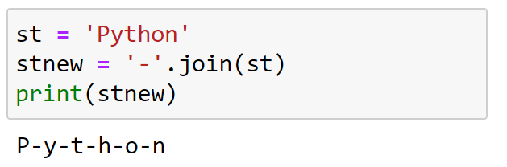
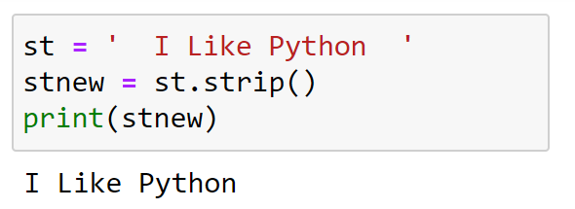
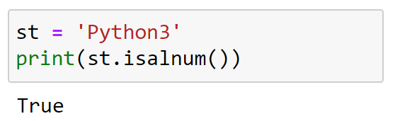
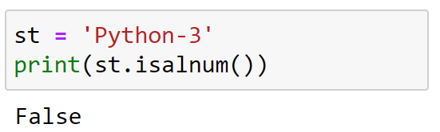
String Built in methods:
Method Name | Explanation | Code Snippet
join() | Concatenate any number of strings. The string whose method is called is inserted in between each given string. The result is returned as a new string
strip() | Return a copy of the string with leading and trailing whitespace removed.
isalnum() | Return true if the string is alphanumeric (Combination of a-z, A-Z, 0-9) Note – It will return false only if string contains special character.

Slide 34
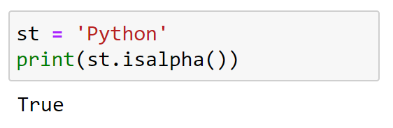
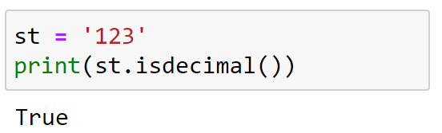
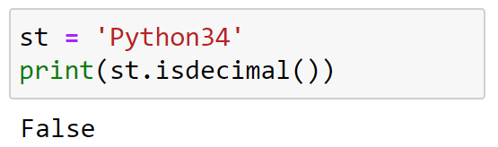


String Built in methods:
Method Name | Explanation | Code Snippet
isalpha() | Return true if the string contains only alphabets(Combination of a-z, A-Z)
isdecimal() | Returns True if all characters in the string are decimals
islower() | Returns True if all characters in the string are lower case

Slide 35

String Built in methods:
Method Name | Explanation | Code Snippet
len() | Return length(No of character) of a given string. This is a generic function.

Slide 36
Basic Operations in String:
Strings in Python support basic operations like concatenation, replication and membership
Concatenation means joining/combining two string into one.
Replication means repeating same string multiple times.
Membership tells a given string is member of another string or not.

Slide 37




Operations in String:
Method Name | Explanation | Code Snippet
+ | Concatenation It will merge/join second string at the end of first string and return.
* | Multiply (Replicas) It will repeat same string multiple times and return. Note – multiply string only with integer number.
in | Membership It will check a given substring is present in another string or not. Note – gives bool value (True/False)

Slide 38

Operations in String:
Method Name | Explanation | Code Snippet
Not in | It's reverse of Membership

Slide 39
String Formatters:
String formatting is the process of infusing things in the string dynamically and presenting the string.
Why to use String Formatter??
For different types of requirement to print the string in a formatted manner.
Here, format implies that in what look and feel we want our strings to get printed.
Python string provides a number of options for formatting.

Slide 40
String Formatters:
String formatting is the process of infusing things in the string dynamically and presenting the string.
Why to use String Formatter??
For different types of requirement to print the string in a formatted manner.
Here, format implies that in what look and feel we want our strings to get printed.
Python string provides a number of options for formatting.

Slide 41



String format Style:
Escape Sequence | Explanation | Example
\newline | Ignores newline
\\ | Backslash Write a backslash in string
\' | If we need to use single quotes in our string like Good Morning! Mr. 'BOB'

Slide 42


String format Style
Escape Sequence | Explanation | Example
\" | If we need to use double quotes in our string like Good Morning! Mr. 'BOB'
\n | Newline

Slide 43

String Format()
Method 1: It is a beneficial method for formatting strings; it uses {} as a placeholder.
We have placed two curly braces and arguments that give the format method filled in the same output.

Slide 44

String Format()
If we want to change the order of , we can give an index of parameters of format method starting with 0th index.

Slide 45

String Format()
We can also use keywords arguments in format method, as shown in the following example, as shown in figure.

Slide 46

String Format()
We can also use format specifier in format method like in language ‘C’. Format specifier are used to do following.
Represent value of amount = 12.68456 at two decimal place
Represent value of integer in Binary, Octal or Hexadecimal etc.
Note: In the above example b is used for binary representation.

Slide 47



Format Specifiers
Format Specifier | Explanation | Example
b | Use for Binary
o | Use for Octal
X or x | Use for Hexadecimal

Slide 48


Format Specifiers
Format Specifiers | Explanation | Example
d | Use for Decimal
f | Use for Float Note – Place .n before f, for representing floating point precision. n is decimal places.

Slide 49

Formatting using f-string
Fstring is the way of formatting as format method does but in an easier way.
We include ‘f’ or ‘F’ as a prefix of string.

Slide 50

Can you answer these questions?
What will be the output of the following code snippet?
Hello how are you
Hello how are
hello how are you
Hello how re you

Slide 51

Can you answer these questions?
2. What will be the output of the following code snippet?
True
False
Error
None

Slide 52


Loops with Strings:
Strings are sequence of character and iterable objects, so we can directly apply for loop through string.
Example-1
Scan/Iterate each character of string through index using for loop.
Example -2
Scan/Iterate each character of string directly using for loop

Slide 53

Loops with Strings:
Example 3 – Write a program to print number of alphabets and digits in a given string.

Slide 54

Loops with Strings:
Example 4
To add 'ing' at the end of a given string (length should be at least 3).
If the given string already ends with 'ing' then add 'ly' instead.
If the string length of the given string is less than 3, leave it unchanged.
Sample String : 'abc'
Expected Output : 'abcing’
Sample String : 'string'
Expected Output : 'stringly'
.

Slide 55
List
.
Python List is the most commonly used sequence.
Important points about list are as follows.
List elements are enclosed in square brackets [] and are comma separated.
List is the sequence of class type ‘list’.
List can contain elements of different data types.
List is a mutable(changeable) sequence, would be discussed in detail in 3.2.3
List allows duplicate elements.
List elements are ordered, it means it give specific order to the elements, if new element is added, by default it comes at the end of the list.

Slide 56

List
Real World Scenario:
List is used when there is a possibility of elements of different data type.
For example record of a particular student, having name as string, roll.no as integer, marks as float, father’s name as string.
To contain this record list is the appropriate sequence.
List Representation

Slide 57

List Example
In this example a variable named list example has been created and three elements have been assigned.
As we have enclosed elements in square brackets, this makes list example is of type list.

Slide 58

Ordered Property of List
Ordered sequence of the list means the order in which elements appear is unique
The position of every element is fixed.
If we change the position of any element, then list would not be the same anymore.

Slide 59


Creation of List
List can be created by many ways as follows.
Creation of Empty List
Creation of Non Empty List

Slide 60

Accessing the List
Indexing the List
In the list index are started from 0, it means first element takes 0 index and it increases like 0,1,2…(n-1).
List also supports negative indexing.
It means last element can be accessed using -1 index, second last as -2 and so on.

Slide 61

Slicing
Slicing is used to get substring from a string.
We use Slice operator in the list to get a sub list.
Start= Optional argument by default value is 0.
End = Optional argument by default value is number of elements in the list. If any number given, then value is taken as number-1.
Step=Options argument by default value is 1.
Colon 1: Required
Colon 2: Optional

Slide 62

Slicing Example
Single colon[:]- It is used to print the entire list.
Double colon[:]- It is used to print the entire list.
l[2::]-It is used to print the list starting from index 2 till the last element of the list.
L[2:5:]- We have set start and end both as 2 and 5, so it’s starting from 2 and ending with (5-1) and printing values for indexes 2,3 and 4 index.
L[2:5:2]-end and step has been set as 2,5 and 2. So output substring starting from index 2, ending with 5-1=4 and step counter is 2, so its skipping alternate element.

Slide 63



Examples of List Slicing
Operator | Explanation | Example
[:] | This gives a complete original list
[1:3] | It starts with 1th index and ending with (3-1=2) index
[2:] | Sub list starts with index 2 and ends at last element as nothing specified on right side of the colon

Slide 64



Examples of List Slicing
Operator | Explanation | Example
[1:4:] | Start=1, stop=4 and by default step=1.
[1:4:2] | Start=1, stop=4 and by step=2. As the step is 2, it took every 2nd element.
[::-1] | Starting is 0th index and stopping at last index and step is negative count so that it would print in reverse order

Slide 65

Updation in List:
List updating involves insertion of new elements, deletion of elements or deletion of complete list.
List is a mutable sequence it means it allows changes in the elements of list.

Slide 66
Updation in List:
List updating involves insertion of new elements, deletion of elements or deletion of complete list.
List is a mutable sequence it means it allows changes in the elements of list.

Slide 67

Can you answer these Questions
1.What is the output of the following code?
A.[‘XY’,’YZ’]
B.[‘xy’,’yz’]
C. None of the above
D. Both of the above

Slide 68

Can you answer these Questions
2.What is the output of the following code?
[‘g’,’h’,’k’,’l’,’m’]
B. [‘g’,’h’,’k’,’l’,’m’,9]
C. [‘g’,’h’,’k’,’l’,’m’,8,9]
D. [‘g’,’h’,’k’,’l’,’m’,9,8]

Slide 69

Add new element in List:
We can add elements to the existing list using append function.
Append function always add the element at the end of the list.
Syntax:
Listname.append (element to be added)
In this example element 5 has been appended in the originally existed list. It’s being added in the last

Slide 70

Changing new element in List:
Value of the element at index 3 has been assigned new value as 5, so element in the output list is changed from 4 to 5.

Slide 71

Deletion in List:
List elements can be deleted.
Using del command If we know the position(index) of the element which is to be deleted.
We can use the remove method by giving the specific element as given in the example If we know the position(index) of the element.

Slide 72

Deletion in List:
list1 has been deleted and then we are trying to print it and its giving error because it does not exist now.

Slide 73




Built in Methods in List
Method | Remark | Example
len() | It calculates the length of the list or the number of elements in the list.
max(list) | It returns the maximum element from the list
min(list) | It returns a minimum element from the list
list(seq) | It converts into any sequence into a list

Slide 74




Contd..
Method | Remark | Example
pop() | It deletes the last element from the list Note – We can also pass index as argument in pop() to delete a specific index value.
count() | It counts the occurrences of a particular element in the list
sort() | Sort the elements of the list in ascending order
reverse() | Sort the elements of the list in reverse order

Slide 75


Operations on List
Python supports variety of operations on the list
Operation | Remark | Example
Concatenation | Operation adds two list elements
Repitition | It repeats the list specified number of times

Slide 76


Contd..
Python supports variety of operations on the list
Operation | Remark | Example
Membership | To check whether an element belongs to the list or not
Membership not | I return true of an element that does not belong to the list

Slide 77

Example
Write Python Program to swap elements in the list.

Slide 78
Practice Problems
Take a list input from user having integer elements and calculate sum and average of the list.
Take an input list and swap string elements of the list with empty string.

Slide 79


Loops with List
While loop with list
For Loop with list

Slide 80

Example
Write a python program to print all positive number of a list.
Practice Exercise:
Write a python program to remove duplicate from the list.
Write a python program to count positive, negative and string type elements.

Slide 81

Nested List
When we have an element of a list in the form of the list itself, it is called Nested List.
Elements of the nested list can be accessed using the 2-D indexing access method.
.
In this example, first [1] denotes [3,4] and second [1] represents 4, so it gives output as 4.

Slide 82

Nested List as a Matrix
We can represent nested list as matrix also.
For this we would use nested for loop.
Outer loop would run for number of elements in the list and inner loop would consider individual element of the nested list as a list.
.
.

Slide 83

Example
Create a flat list from a nested list.
.
Practice Exercise:
Using nested list print transpose, of a given matrix
Print reverse order of a nested list
.

Slide 84


List Comprehensions
Let's suppose we want to write a program to calculate powers of 3 for a given range.
Traditional Programming
Python provide us writing iterative programs in much lesser lines called List comprehension.
The same problem has been solved using list comprehension.
.

Slide 85


List Comprehension
Syntax:
[ statements for an item in list ]
IF ELSE :
We should notice one change that because in if-else case output is separated based on the condition.
if-else and conditions has been written along with statements.
We have the facility of adding conditionals in the list comprehension.
.

Slide 86

Can you answer these questions?
1. What will be the Output of the following code?
A.[0,1,2,3,4,5]
B.[0,1,2,3,4,5,6]
C.[0,1,2,3]
D. None of the Above
.

Slide 87

Can you answer these questions?
2. What will be the Output of the following code?
A. [5,7,9]
B.[3,4,5]
C.[6,7,8]
D.[9,10,11]
.

Slide 88

Tuple
Tuple is an immutable (unchangeable) ordered collection of elements of different data types.
Generally, when we have data to process, it is not required to modify the data values.
Take an example of week days, here the days are fixed. So, it is better to store the values in the data collection, where modification is not required.
.

Slide 89



Creation of Tuple
Creation of Empty Tuple
Creation of Non Empty Tuple
Syntax of Creating Non Empty Tuple
In above example, the () round brackets are used to create the variable of tuple type.
We can also call the class to create a tuple object as shown in example below.
.

Slide 90

Example
Write a program in python to create one element in tuple
If you want to create a tuple with single value, it is required to add a comma after the single value as shown in the above example c=(‘college’,).
If the comma is not placed, then the single value a= (1) or b=(ABES) will be treated as an independent value instead of the data collection.
.

Slide 91

Packing and Unpacking of Tuple
Tuple can also be created without using parenthesis; it is known as packing.
Write a program to create tuple without parenthesis.
In above example 1, newtup4=3,4,5,” hello” creates a new tuple without parenthesis.
.

Slide 92

Unpacking of Tuple
Write a program to unpack elements in tuple
Unpacking is called when the multiple variables is assigned to a tuple; then these variables take corresponding values.
Practice Questions:
Write a Python program to create the colon of a tuple.
Write a Python program to unpack a tuple in several variables.
.

Slide 93

Accessing Elements in Tuple
Tuple elements can be accessed using indexes, just like String and List .
Each element in the tuple is accessed by the index in the square brackets [].
An index starts with zero and ends with (number of elements - 1)
Example:
Write a program to access index 1 element from tuple.
In above example 1: tuple newtup carries multiple types of data in it as “hello” is string, 2 is integer, and 23.45 is float. If we can fetch the index 1 element using print(newtup[1]).
.

Slide 94

Contd…
Write a program to access index 0 element from tuple.
Basically, the -1 index will return the last value of tuple.
Indexes start from zero, and it goes up to a number of elements or say -1.
Take another example to fetch the -1 index from tuple.
last element is accessed by print(tuple_days[-1]).
.

Slide 95


Indexing in Tuple and Slicing
Slicing in a tuple is like a list that extracts a part of the tuple from the original tuple.
Write a program to access elements from 0 to 4 index in tuple.
Write a program to access elements from 1 to 3 index in tuple.
.

Slide 96

Modification/Updating a Tuple
If we want to change any of the index value in tuple, this is not allowed and throw an error.
Tuple object does not support item assignment.
Here, we are taking the same above example of days and showing the immutable characteristic of tuple
.

Slide 97
Practice Exercises
Write a Python program to get the 4th element and 4th element from last of a tuple.
Write a Python program to check whether an element exists within a tuple.
.

Slide 98
Built in Methods in Tuple
Tuple has 2 Built in methods
.

Slide 99




Operations on Tuple
Tuple has some operations, which are listed below:
Operations | Remarks | Example
Concatenation | Add two tuples
Multiplication | Creates copies of the tuple
Membership | To check whether an element belong to tuple or not
Not Membership | Would return true if element does not belong to tuple.
.

Slide 100

Loops and Conditions on Tuples
Tuple can be traversed using Loop
Take the tuple named tuple_days and print all its elements
In this example The elements are printed while iterating through for loop condition for in tuple_days and then we print the values of i in each iteration.

Slide 101

Loops and Conditions on Tuples
Example:
Let have a look to the example where we are placing a condition to return the values having word length greater than 3.
In above example , The elements are printed while iterating through for loop condition for in tuple_days and then we print the values of i in each iteration with the condition if(len(i)>3)

Slide 102
Comparison between List and Tuple

Slide 103

Practice Exercises:
Exercise: Write Python program to join two input tuples, if their first element is common.

Slide 104

Dictionaries
Dictionary is a unique data collection of Python which stores the key-value pair.
The user can add an element by giving a user-defined index called a key.
Each key and its corresponding value makes the key-value pair in dictionary.
This key-value pair is considered as one item in dictionary.

Slide 105

Introduction
In dictionaries, the indexes are not by default. (such as 0 in string, list, tuple).
{} is the representation of Dictionary
Creation of Dictionary
An empty dictionary can be created as

Slide 106

Example-1
Creating an empty dictionary

Slide 107

Example-2
Creating a non-empty dictionary

Slide 108

Accessing of Dictionary
In dictionary, the items are accessed by the keys.

Slide 109
Can you answer these questions?
Output of following code?
A) ‘Java’
B) ‘Python’
C) KeyError
D) None of above

Slide 110

Can you answer these questions?
2. Output of following code?
A) 5
B) 10
C) 15
D) None of above

Slide 111
Accessing of Dictionary
List
By Default indexing
Indexes are only of integer type
Dictionary
User defined Keys
Keys can be of any type
Adds an element to the next default index
Adds an element to the user defined key location
Fetching of element is through index, lst[0]
Fetching of value is through keys, dic[<key>]
Traversing is easy just by increase the index, i+=1
Traversing is easy just by increase the index, i+=1

Slide 112

Modification in a Dictionary

Slide 113

Can you answer these questions?
Output of following code?
A) {1:’Store’,2:’Kitchen’}
B) {2:’Store’,1:’Kitchen’}
C)KeyError
D) None of above

Slide 114

Can you answer these questions?
2. Is it possible to change key in dictionary?
A) True
B) False

Slide 115

Nested Dictionary
As we have the option of a nested list, similarly, dictionaries can consist of data collections.

Slide 116
Built-in Methods in Dictionary
Method | Description
copy() | Copying a dictionary to another dictionary
fromkeys() | Create a new dictionary with key in a data sequence list/tuple with value
get() | If the key is present in the dictionary, its value is returned. If the key is not present in a dictionary, then the default value will be shown as output instead of a KeyError.
items() | this will return the key-value pair as an output.
keys() | this will return only the keys as an output.
values() | this will return only the dictionary values as an output.
update() | this adds the one dictionary with another dictionary.
pop() | The pop() method takes an argument as the dictionary key, and deletes the item from the dictionary.
popitem() | The popitem() method retrieves and removes the last key/value pair inserted into the dictionary.

Slide 117


copy()
copy() method provide a fresh copy with different memory location.
Output

Slide 118

fromkey()
Output

Slide 119


get()
Output

Slide 120


items(),keys(),values()
Output

Slide 121


update()
Output

Slide 122


pop(),popitem()
Output

Slide 123
Loops and conditions on dictionaries
Loops and conditions can easily apply to dictionaries.
dict1={1:1,2:4,4:8,6:36}
for key in dict1.keys(): print(key) | for val in dict1.values(): print(val) | for item in dict1.items(): print(item) | for i,j in dict1.items(): print(i,":",j)
OUTPUT
1 2 4 6 | 1 4 8 36 | (1,1) (2,4) (4,8) (6,36) | 1:1 2:4 4:8 6:36

Slide 124

Can you answer these questions?
Output of following code?
A) {1:1,2:4,3:9,4:16,5:25,6:36}
B) {1:1,2:4,3:9,4:16,5:25}
C) [1,4,9,16,25]
D) Error

Slide 125
Can you answer these questions?
Output of following code?
A) {1:’Store’,2:’Kitchen’}
B) {2:’Store’,1:’Kitchen’}
C)KeyError
D) None of above

Slide 126
Set
A set is another data collection data types in python, which stores unique elements in an unordered way.
Every element in a set is unique and immutable(unchangeable), i.e. no duplicate values should be there, and the values can’t be changed.

Slide 127

Creation of empty Set

Slide 128



Creation of non-empty Set

Slide 129


Creation of non-empty Set

Slide 130
Can you answer these questions?
2. Is it possible to create an empty set using like s1={} ?
A) True
B) False

Slide 131

Accessing set
Python set’s item cannot be accessed using indexes.

Slide 132
Built-in Methods in Dictionary
Method | Description
copy() | Copying a set to another set
clear() | Removes all element from set
add() | Adding a new item in set
update() | If the key is present in the dictionary, its value is returned. If the key is not present in a dictionary, then the default value will be shown as output instead of a Key Error.
remove() | to remove the specified element from the given set.
pop() | used to removes a random element from the set and returns the popped (removed) elements.
remove () | used to remove the specified element from the given set.
discard () | used to remove the specified item from the given input set. the remove() method will give an error if the specified item does not exist but this method will not.

Slide 133

copy()
copy() method provide a fresh copy with different memory location.

Slide 134

clear()

Slide 135

add()

Slide 136

update()

Slide 137

remove()

Slide 138

pop()

Slide 139
update()

Slide 140
remove()

Slide 141

discard()

Slide 142
Operators
Set Operation | Description | Operator | Method
Union | All unique elements in set1 and set2 | | | union()
Intersection | Elements present in set1 and set2 | & | intersection()
Difference | Elements that are present in one set, but not the other | - | difference()
Symmetric Difference | Elements present in one set or the other, but not both | ^ | symmetric_difference()
Disjoint | True if the two sets have no elements in common | None | isdisjoint()
Subset | True if one set is a subset of the other (that is, all elements of set2 are also in set1) | <= | issubset()
Proper Subset | True if one set is a subset of the other, but set2 and set1 cannot be identical | < | None
Superset | True if one set is a superset of the other (that is, set1 contains all elements of set2) | >= | issuperset()
Proper Superset | True if one set is a superset of the other, but set1 and set2 cannot be identical | > | None

Slide 143

Union

Slide 144

Intersection

Slide 145

Intersection

Slide 146

Set Difference

Slide 147

Symmetric Difference

Slide 148

Loops with set

Slide 149

Frozen Set
A frozen set is a special category of the set which is unchangeable once created

Slide 150

Frozen Set

Slide 151
Summary
List | Tuple | Set | Dictionary
List is a collection of values that is ordered. | Tuple is ordered and unchangeable collection of values | Set stores the unique values as data collection | Dictionary is a collection of key-value pairs
Represented by [ ] | Represented by ( ) | Represented by { } | Represented by { }
Duplicate elements allowed | Duplicate elements allowed | Duplicate elements not allowed | Duplicate keys not allowed, in dictionary values allowed duplicate
Values can be of any type | Values can be of any type | Values can be of any type | Keys are immutable type, and value can be of any type
Example: [1, 2, 3, 4] | Example: (1, 2, 3, 4) | Example: {1, 2, 3, 4} | Example: {1:1, 2:2, 3:3, 4:4}
List is mutable | Tuple is immutable | Set is mutable | Dictionary is mutable
List is ordered | Tuple is ordered | Set is unordered | Dictionary is insertion ordered
Creating an empty list l=list() l = [] | Creating an empty Tuple t = tuple () t=( ) | Creating a set s=set () | Creating an empty dictionary d=dict( ) d={}

Slide 152
Can you answer these questions?
1. Which of the following Python code will create a set? (i) set1=set((0,9,0)) (ii) set1=set([0,2,9]) (iii) set1={}
A) iii
B) i and ii
C) ii and iii
D) All of Above

Slide 153
Can you answer these questions?
2. What is the output of following code? set1=set((0,9,0))
print(set1)
A) {0,0,9}
B) {0,9}
C) {9}
D) Error

Slide 154
Can you answer these questions?
3. What is the output of following python code?
set1={1,2,3}
set1.add(4)
set1.add(4)
print(set1)
A) {1,2,3}
B) {1,2,3,4}
C) {1,2,3,4,4}
D) Error

